Slide 1
The Data Stream Model
Data is read sequentially in one (or few) passes
We are limited in the size of working memory.
We want to create and maintain a synopsis which allows us to obtain good estimates of properties

Slide 2
Streaming Applications
Network management: traffic going through high speed routers (data can not be revisited)
I/O efficiency (sequential access is cheaper than random access)
Scientific data, satellite feeds

Slide 3
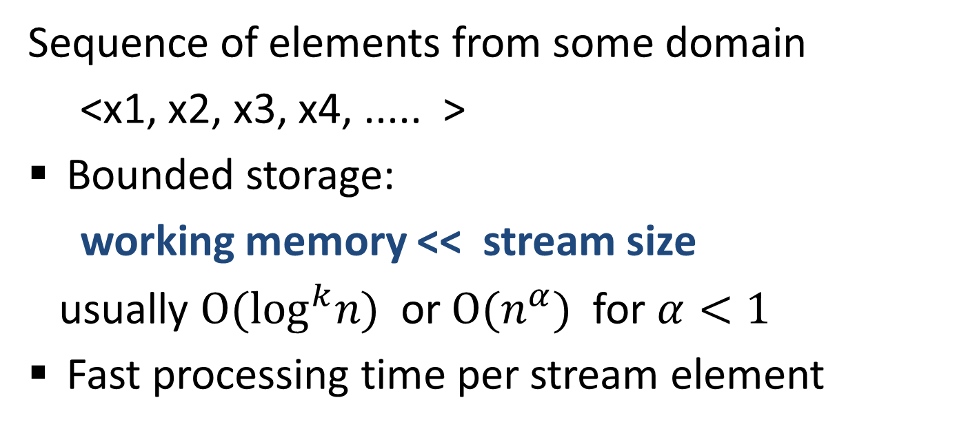
Streaming model

Slide 4
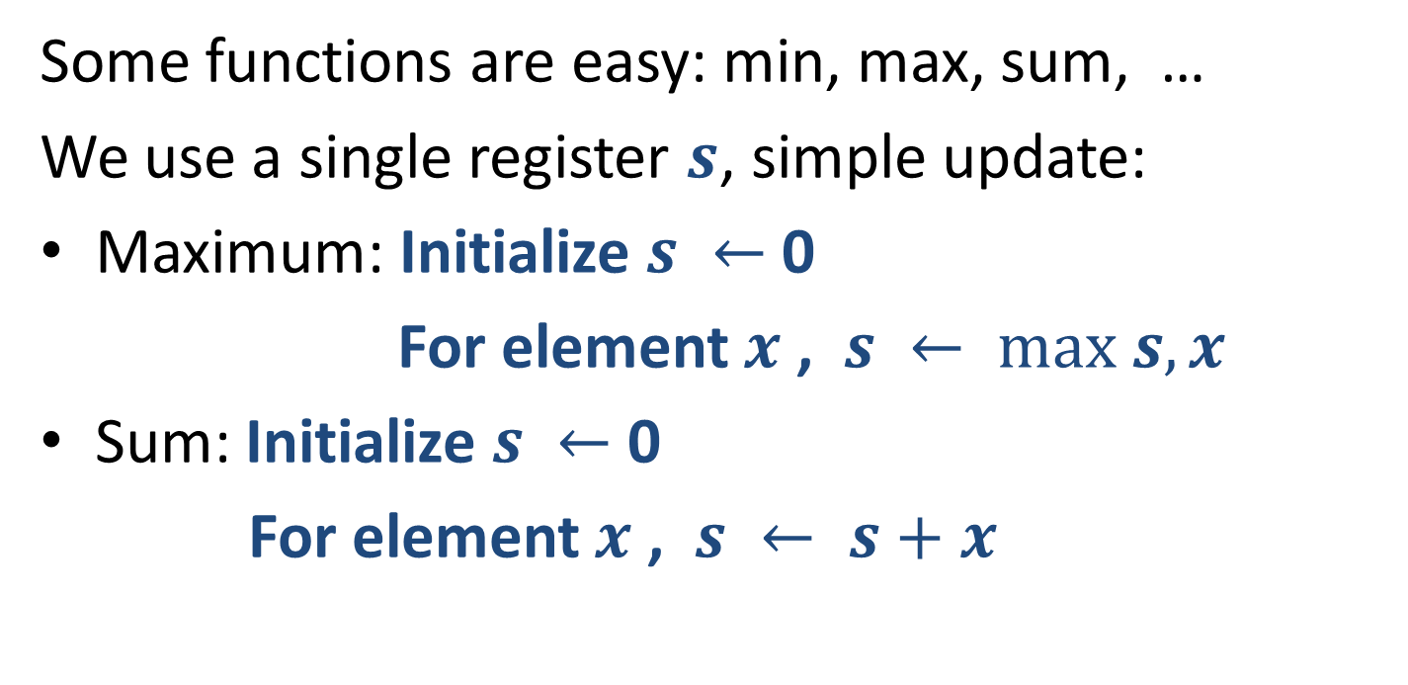
What can we compute over a stream ?
32,
112,
14,
9,
37,
83,
115,
2,
The “synopsis” here is a single value.
It is also mergeable.
Notes:
Application when we need to count many things (network flows) at the same time. Want to use smaller registers.

Slide 5
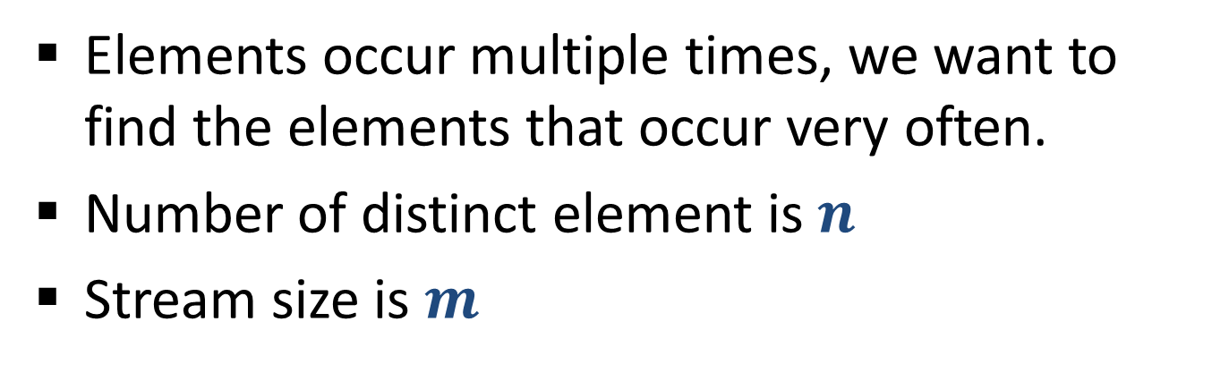
Frequent Elements
32,
12,
14,
32,
7,
12,
32,
7,
6,
12,
4,

Slide 6
Frequent Elements
32,
12,
14,
32,
7,
12,
32,
7,
6,
12,
4,
Applications:
Networking: Find “elephant” flows
Search: Find the most frequent queries
Zipf law: Typical frequency distributions are highly skewed: with few very frequent elements.
Say top 10% of elements have 90% of total occurrences.
We are interested in finding the heaviest elements

Slide 7
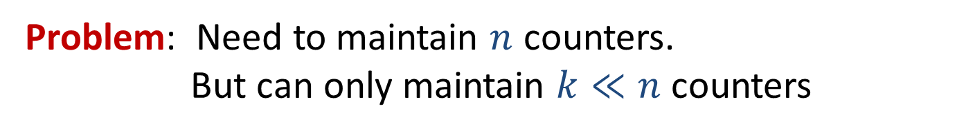
Frequent Elements: Exact Solution
32,
12,
14,
32,
7,
12,
32,
7,
6,
12,
4,
Exact solution:
Create a counter for each distinct element on its first occurrence
When processing an element, increment the counter
32
12
14
7
6
4

Slide 8
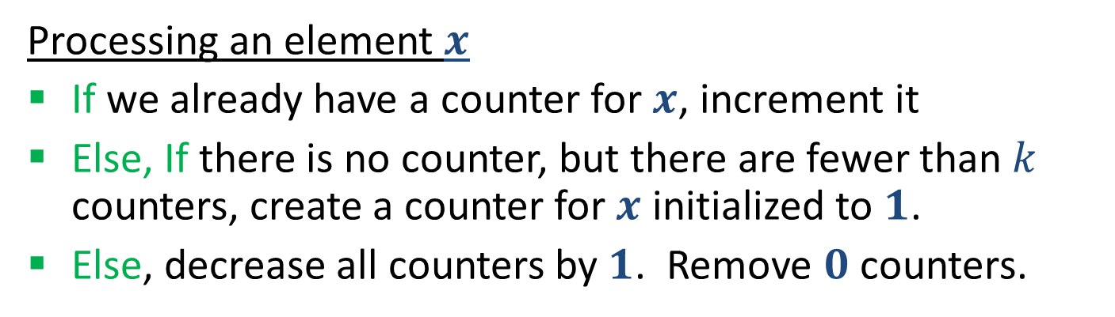
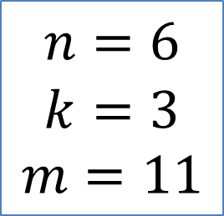
Frequent Elements: Misra Gries 1982
32,
12,
14,
32,
7,
12,
32,
7,
6,
12,
4,
32
12
14
7
6
4

Slide 9
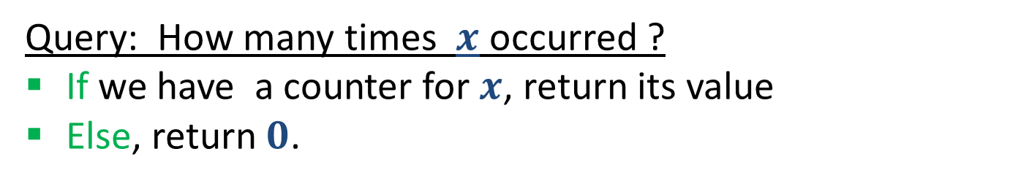
Frequent Elements: Misra Gries 1982
32,
12,
14,
32,
7,
12,
32,
7,
6,
12,
4,

Slide 10
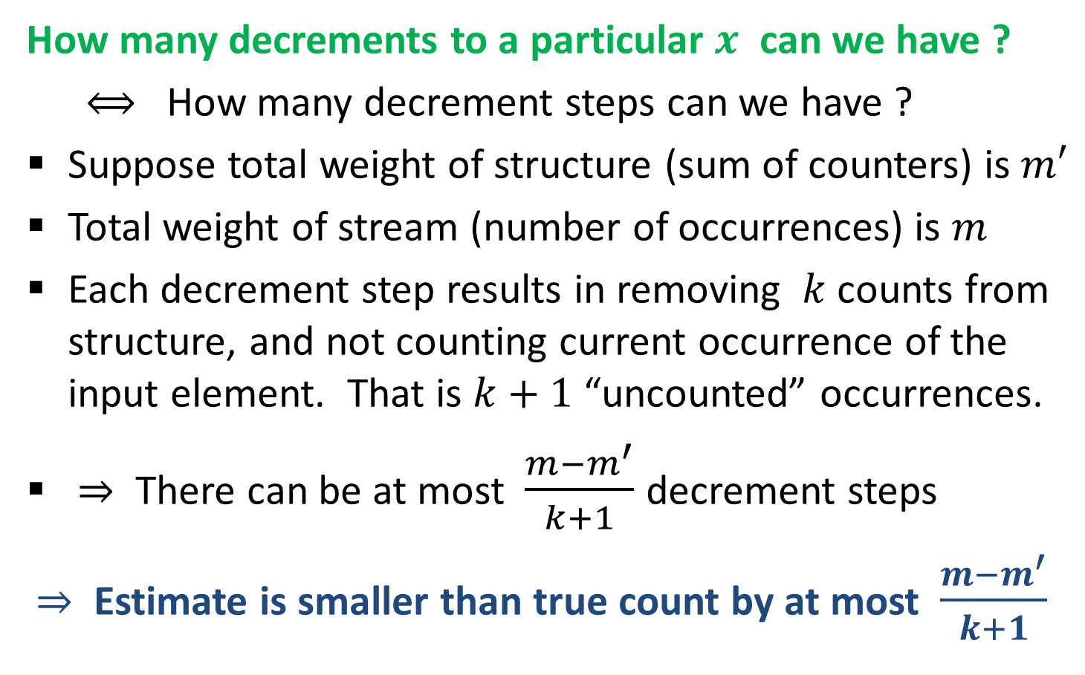
Misra Gries 1982 : Analysis

Slide 11


Misra Gries 1982 : Analysis

Slide 12
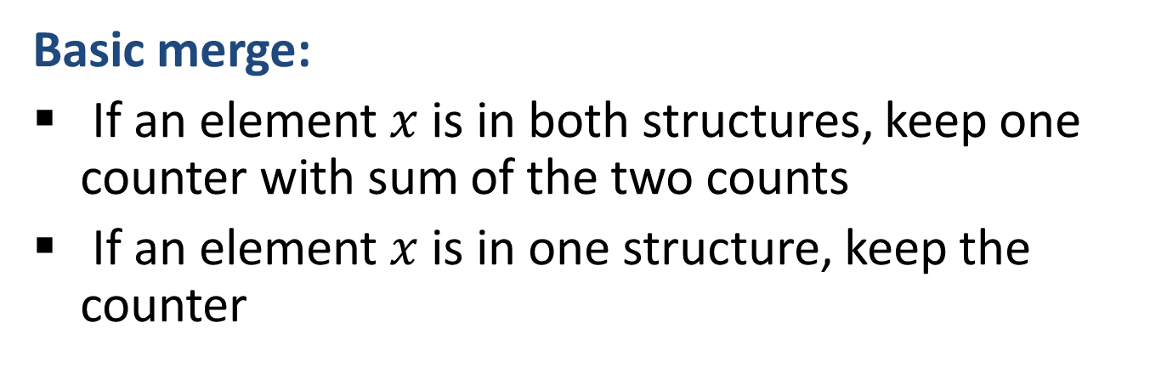

Merging two Misra Gries Summaries [ACHPWY 2012]

Slide 13
Merging two Misra Gries Summaries
32
12
14
7
6
14
Basic Merge:
32
12
14
7
6

Slide 14
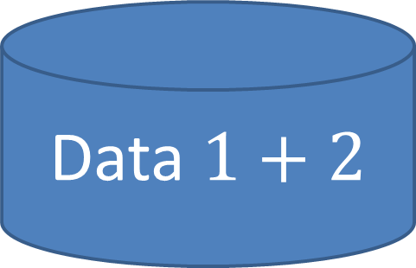
Merging two Misra Gries Summaries
32
12
14
7
6

Slide 15

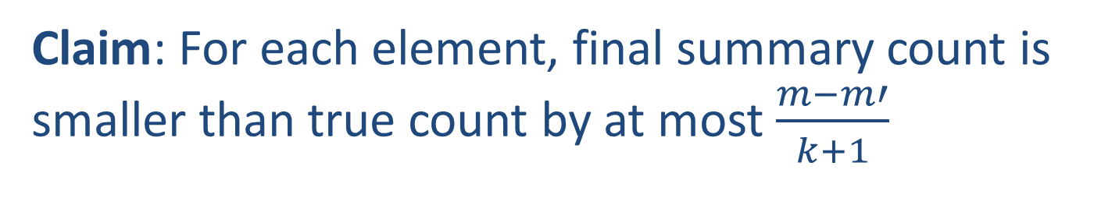
Merging MG Summaries: Correctness

Slide 16
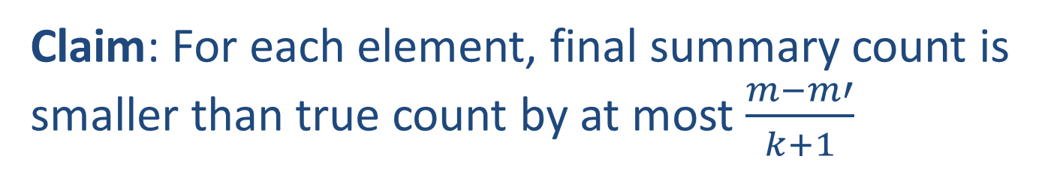
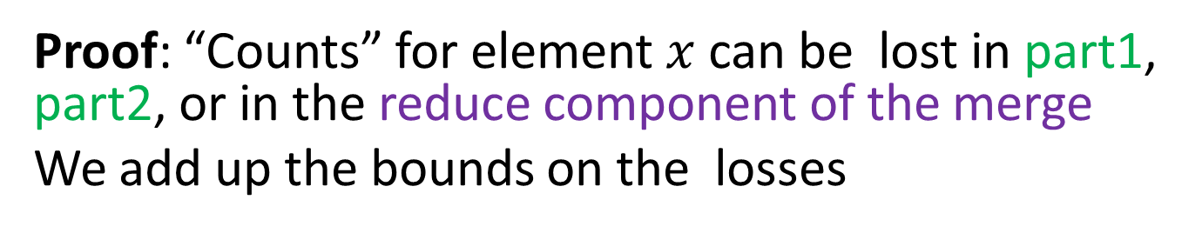
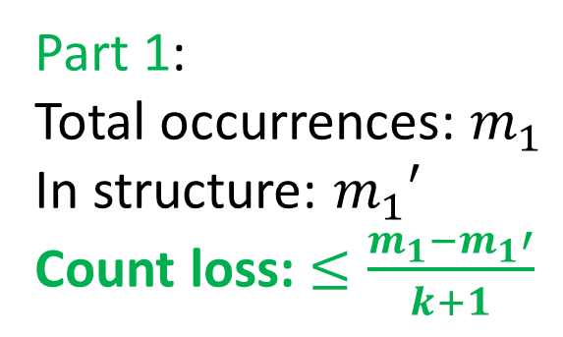
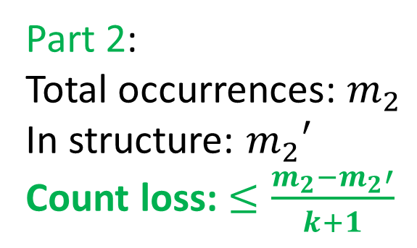
Merging MG Summaries: Correctness

Slide 17
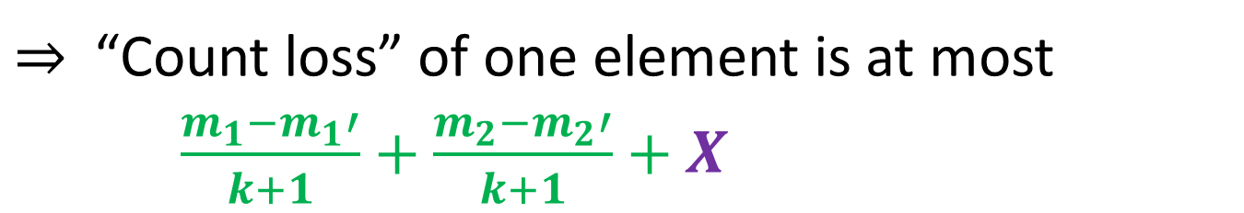
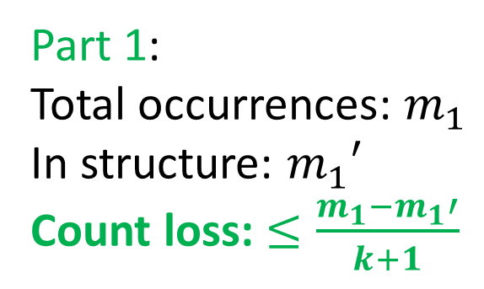
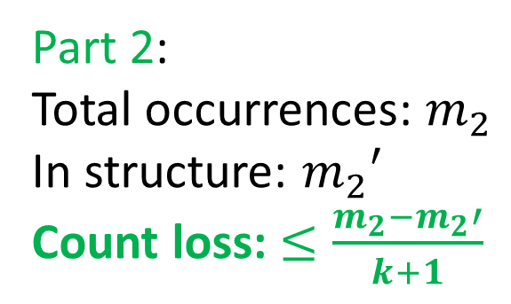
Merging MG Summaries: Correctness

Slide 18
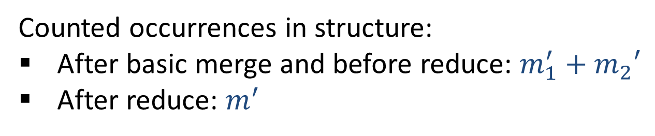
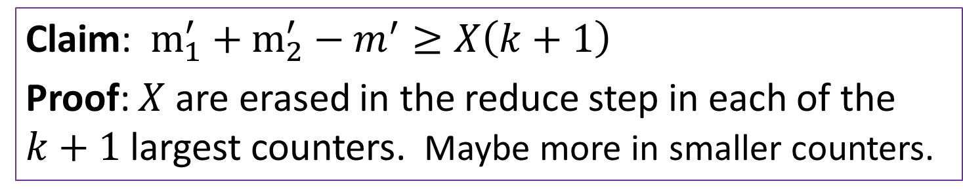
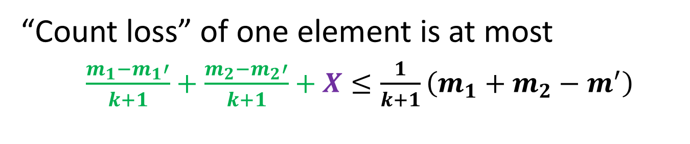

Merging MG Summaries: Correctness

Slide 19

Using Randomization
Misra Gries is a deterministic structure
The outcome is determined uniquely by the input
Usually we can do much better with randomization

Slide 20

Randomization in Data Analysis
Often a critical tool in getting good results
Random sampling / random projections as a means to reduce size/dimension
Sometimes data is treated as samples from some distribution, and we want to use the data to approximate that distribution (for prediction)
Sometimes introduced into the data to mask insignificant points (for robustness)

Slide 21

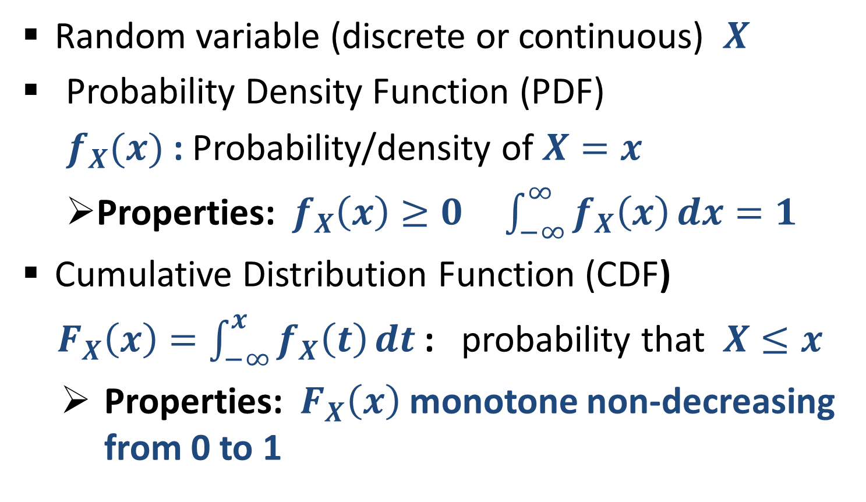
Randomization: Quick review

Slide 22
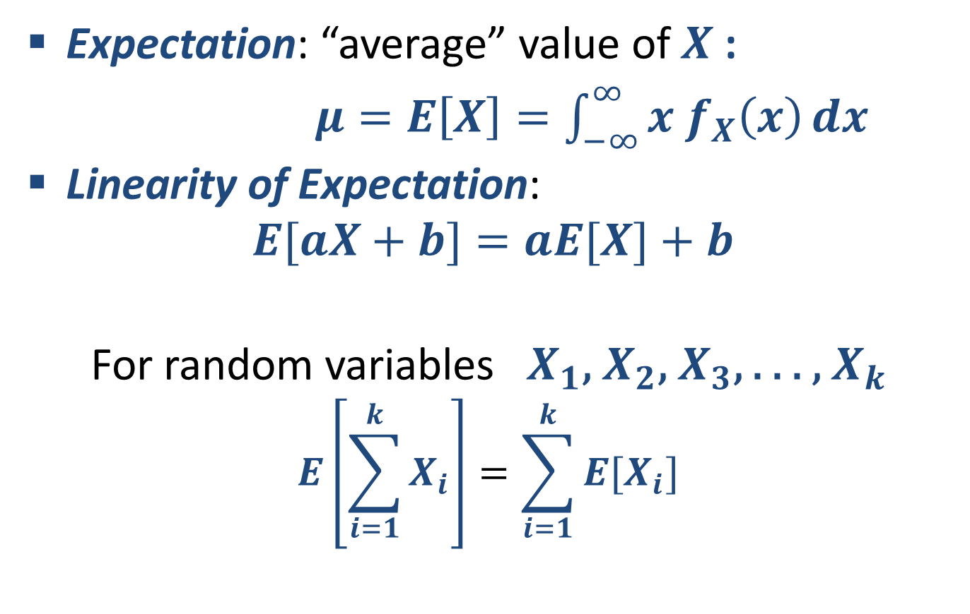
Quick review: Expectation

Slide 23
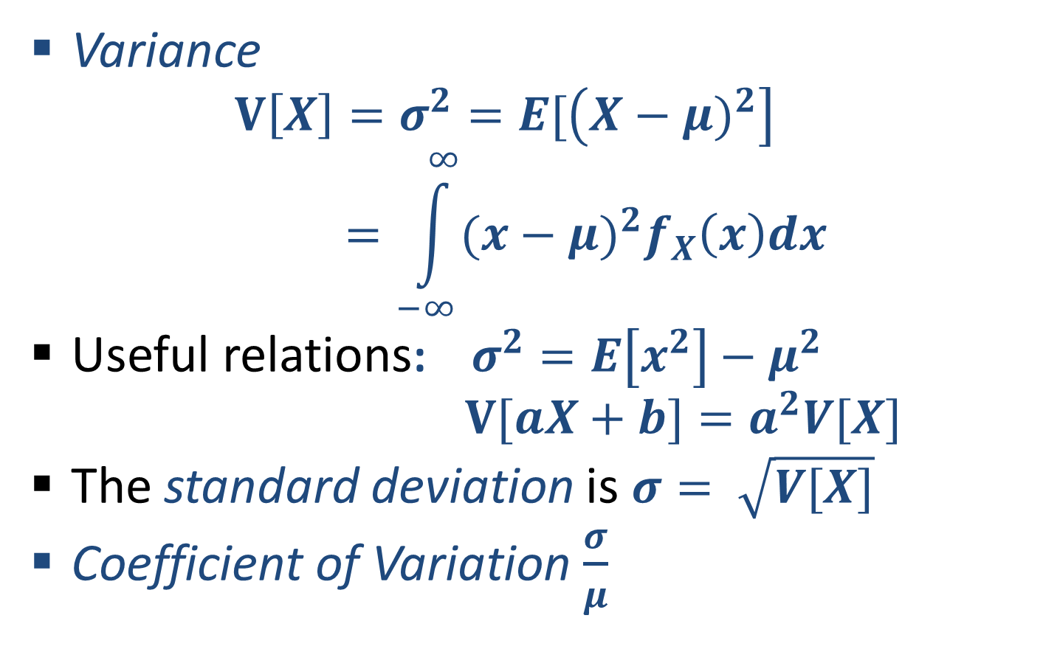
Quick review: Variance

Slide 24
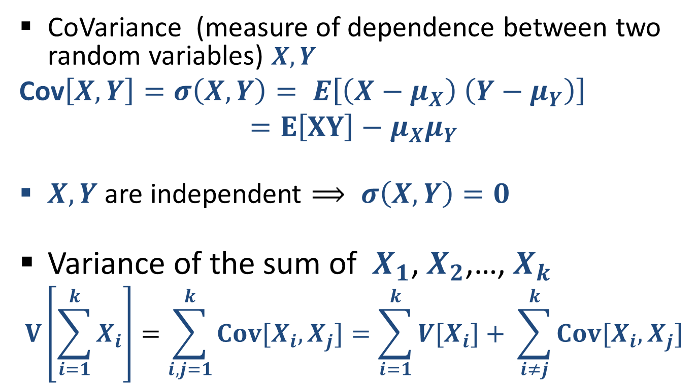
Quick review: CoVariance
When (pairwise) independent
Notes:
Shonut meshutefet mention pairwise independence for “ linearity of variance”

Slide 25
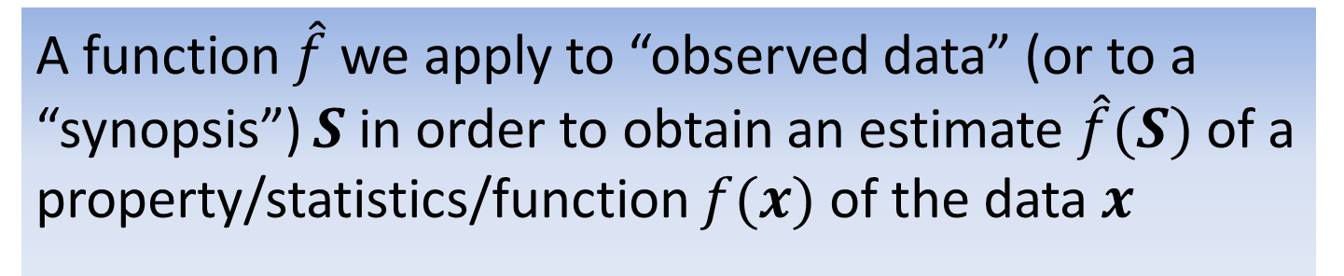
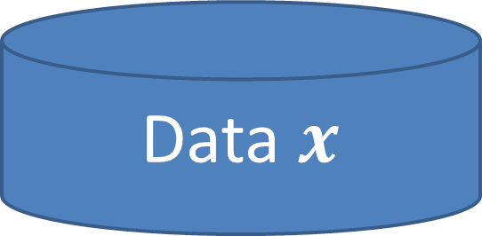

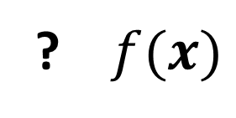
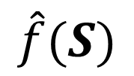
Back to Estimators

Slide 26
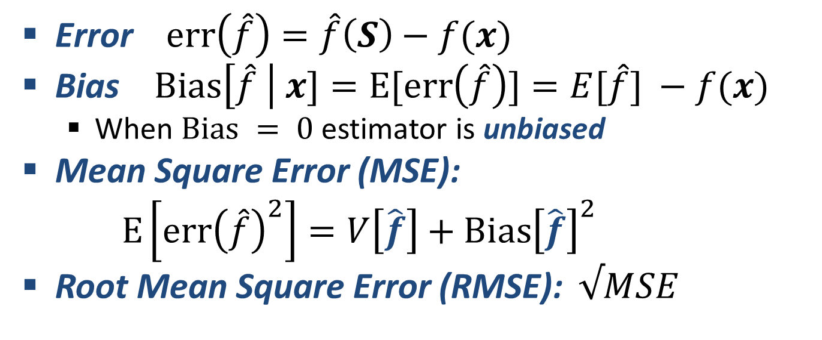
Quick Review: Estimators

Slide 27


Back to stream counting
1,
1,
1,
1,
1,
1,
1,
1,
Can we use fewer bits ? Important when we have many streams to count, and fast memory is scarce (say, inside a backbone router)
What if we are happy with an approximate count ?
Notes:
Application when we need to count many things (network flows) at the same time. Want to use smaller registers.

Slide 28

Morris Algorithm 1978
The first streaming algorithm
1,
1,
1,
1,
1,
1,
1,
1,
Stream counting:
Stream of +1 increments
Maintain an approximate count

Slide 29
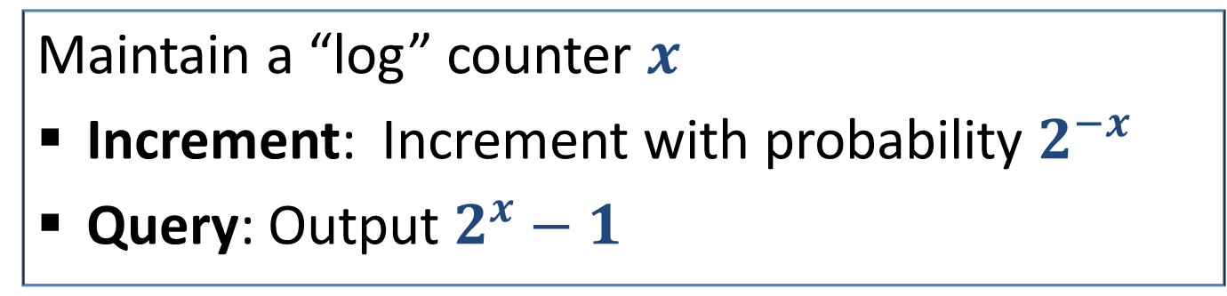









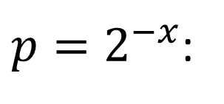


Morris Algorithm
Stream:
1,
1,
1,
1,
1,
1,
1,
1,
1,
2,
3,
4,
5,
6,
7,
8,
1
0
1
1
2
2
2
2
3
3
0
1
1
3
3
3
3
7
7

Slide 30
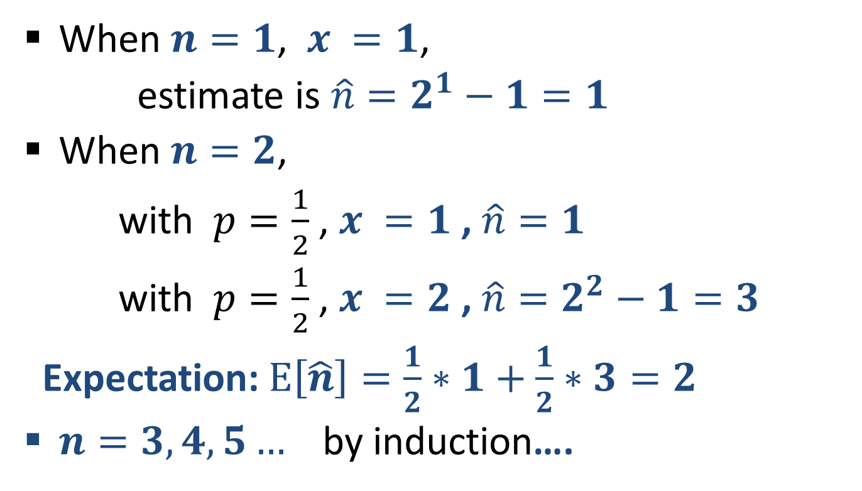
Morris Algorithm: Unbiasedness

Slide 31
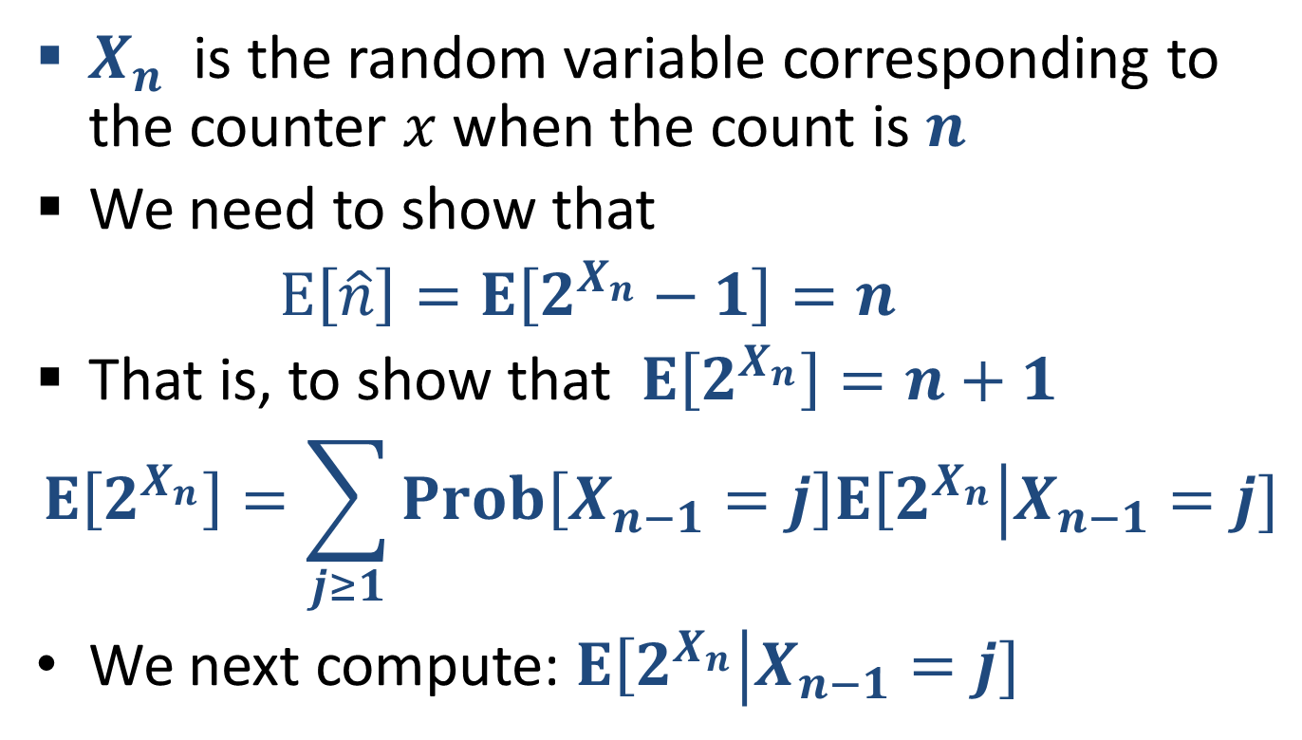
Morris Algorithm: …Unbiasedness

Slide 32
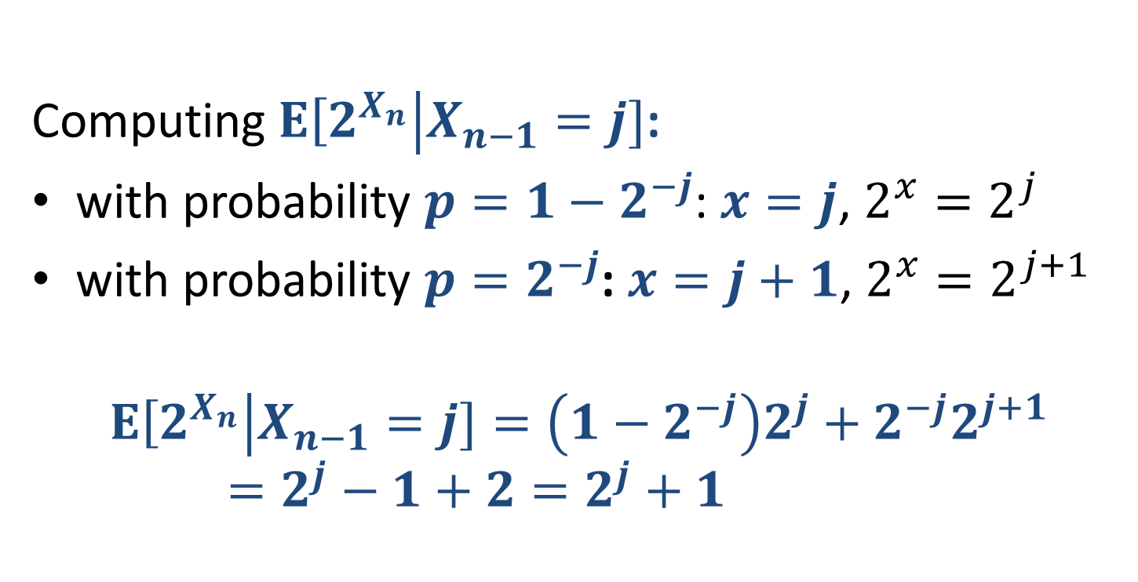
Morris Algorithm: …Unbiasedness

Slide 33

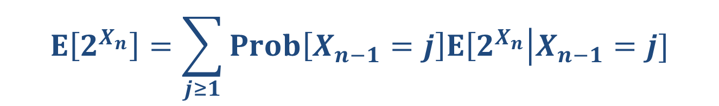
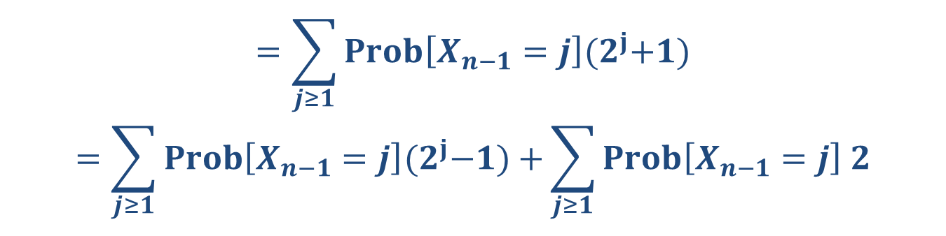
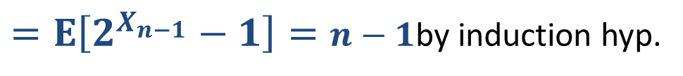


Morris Algorithm: …Unbiasedness

Slide 34
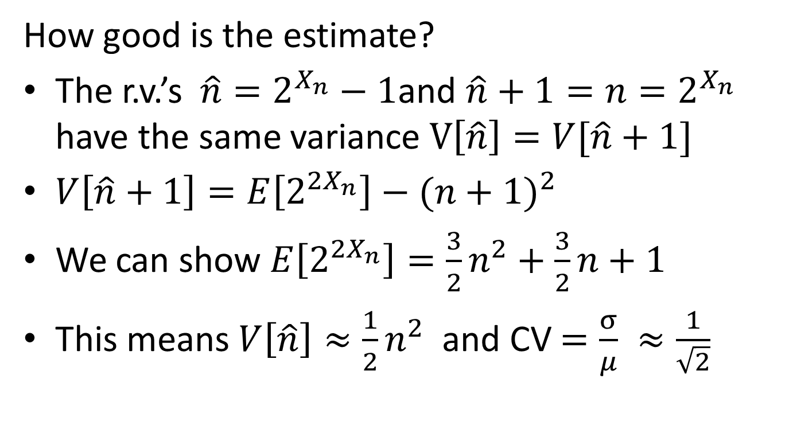
Morris Algorithm: Variance
How to reduce the error ?

Slide 35
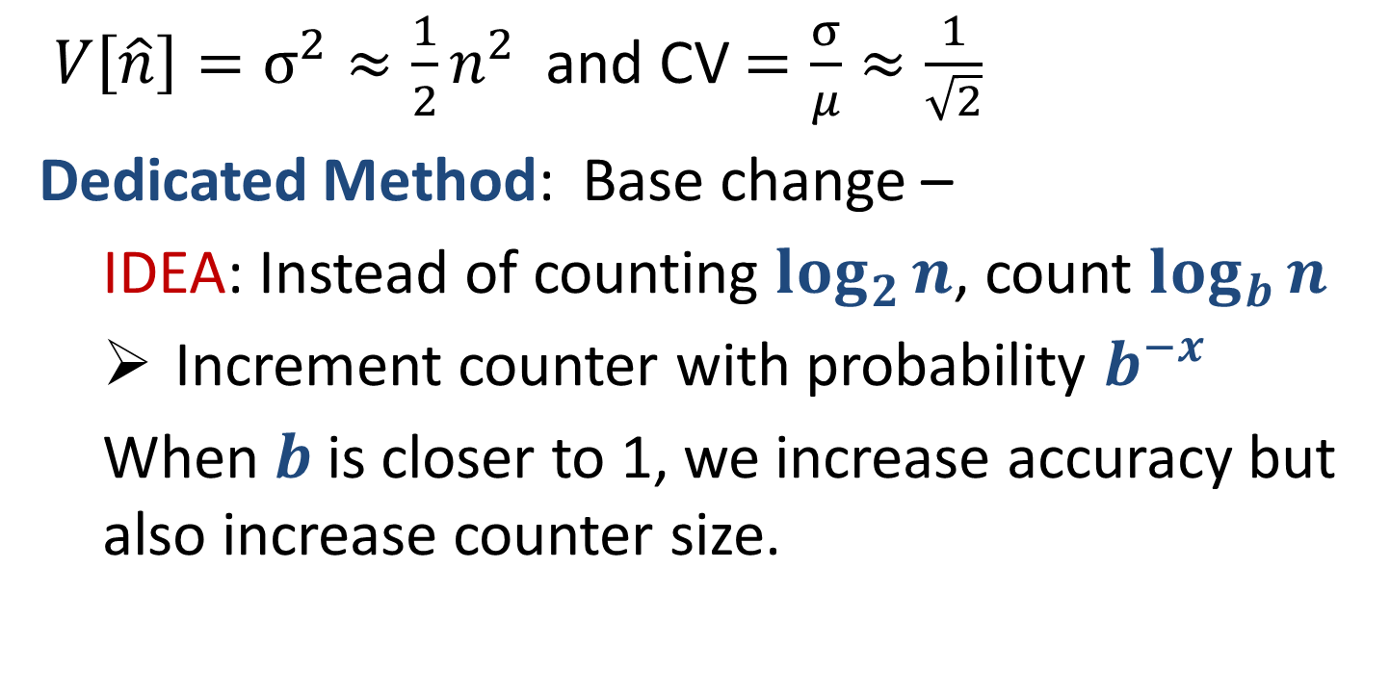
Morris Algorithm: Reducing variance 1

Slide 36
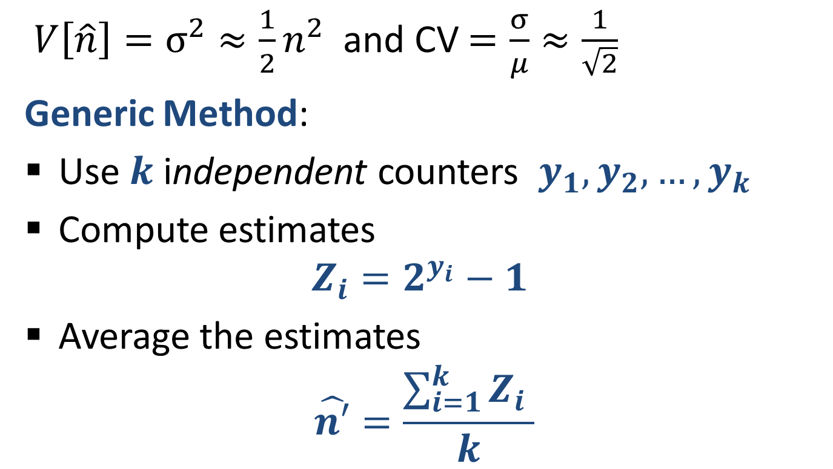
Morris Algorithm: Reducing variance 2

Slide 37
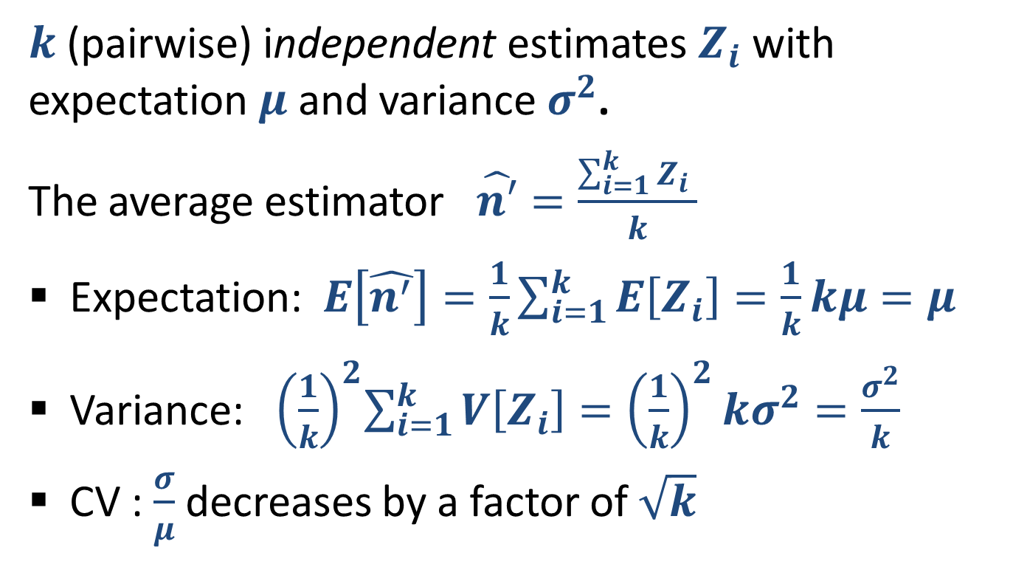
Reducing variance by averaging

Slide 38
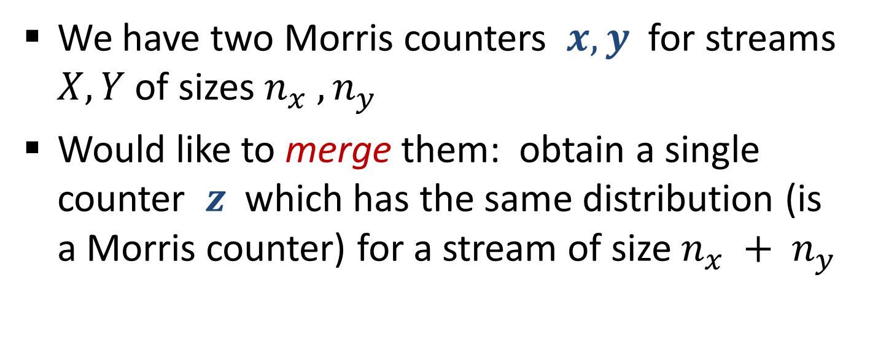
Merging Morris Counters

Slide 39

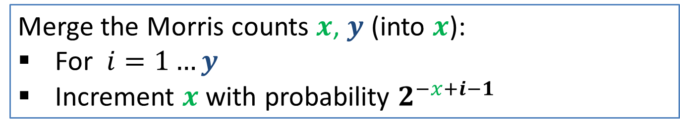
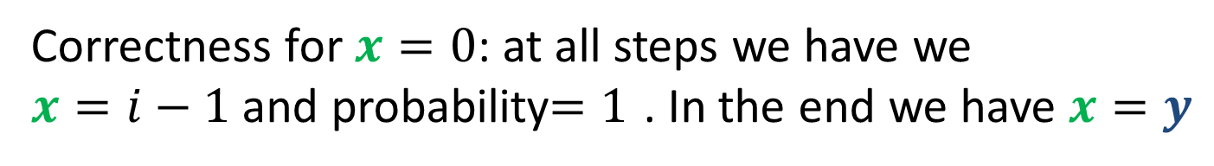
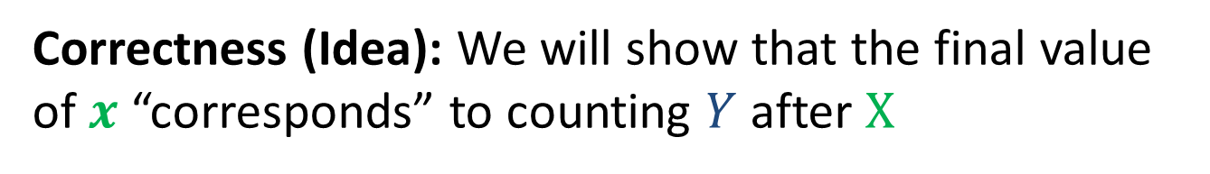
Merging Morris Counters

Slide 40
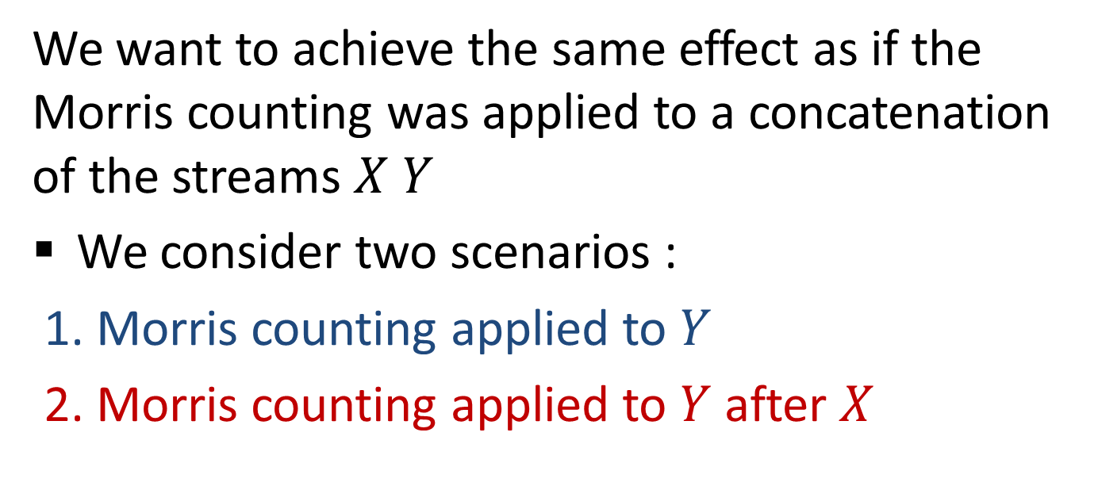

Merging Morris Counters: Correctness

Slide 41
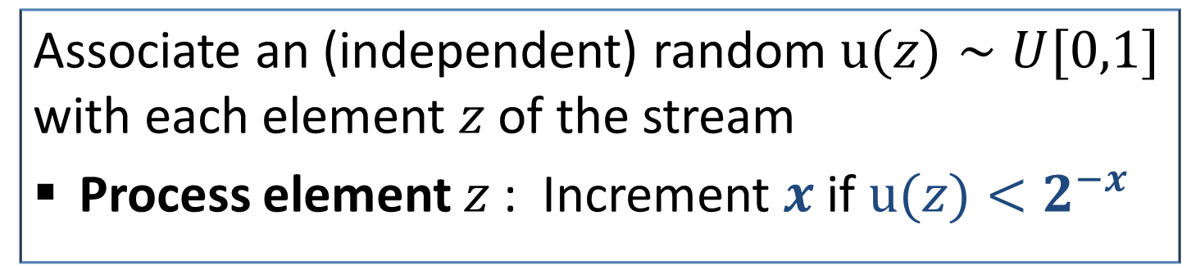
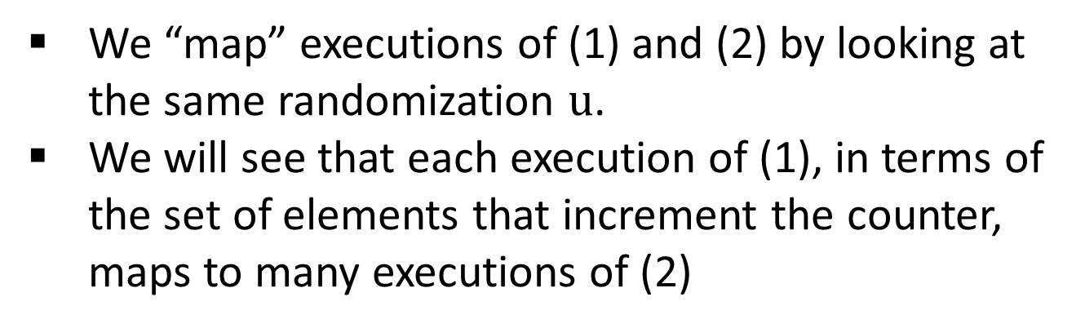
Merging Morris Counters: Correctness
Restated Morris (for sake of analysis only)

Slide 42
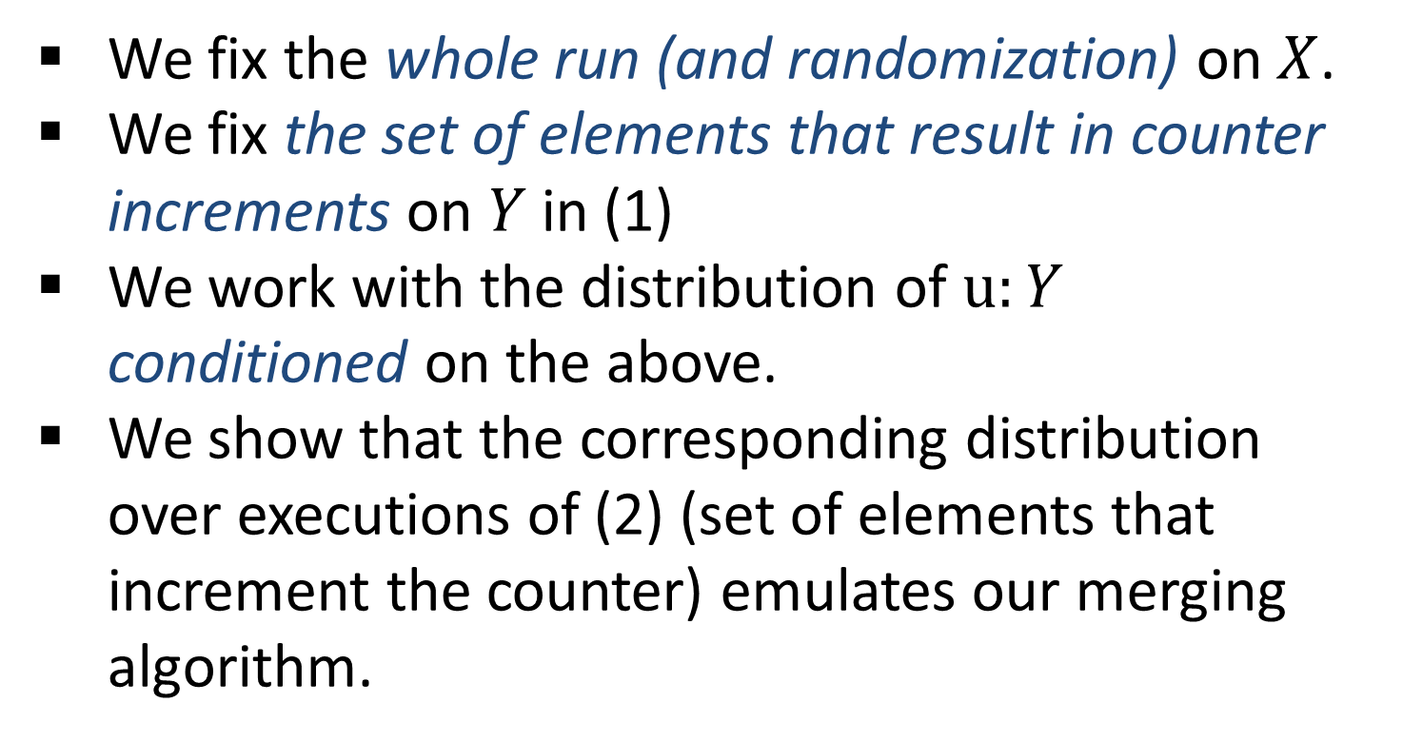
Merging algorithm: Correctness Plan

Slide 43


















What is the conditional distribution?
[0,1]
Stream:
1,
1,
1,
1,
1,
1,
1,
1,
1

Slide 44



Slide 45


Slide 46



Slide 47



Slide 48

Random Hash Functions
Simplified and Idealized
We use random hash functions as a way to attach a “permanent” random value to each identifier in an execution

Slide 49

Counting Distinct Elements
32,
12,
14,
32,
7,
12,
32,
7,
6,
12,
4,

Slide 50
Counting Distinct Elements: Example Applications
32,
12,
14,
32,
7,
12,
32,
7,
6,
12,
4,
Networking:
Packet or request streams: Count the number of distinct source IP addresses
Packet streams: Count the number of distinct IP flows (source+destination IP, port, protocol)
Search: Find how many distinct search queries were issued to a search engine each day

Slide 51
Distinct Elements: Exact Solution
32,
12,
14,
32,
7,
12,
32,
7,
6,
12,
4,
Exact solution:
Maintain an array/associative array/ hash table
Hash/place each element to the table
Query: count number of entries in the table
But this is the best we can do (Information theoretically) if we want an exact distinct count.

Slide 52

Distinct Elements: Approximate Counting
32,
12,
14,
32,
7,
12,
32,
7,
6,
12,
4,

Slide 53
Bibliography
Misra Gries Summaries
J. Misra and David Gries, Finding Repeated Elements. Science of Computer Programming 2, 1982
http://www.cs.utexas.edu/users/misra/scannedPdf.dir/FindRepeatedElements.pdf
Merging: Agarwal, Cormode, Huang, Phillips, Wei, and Yi, Mergeable Summaries, PODS 2012
Approximate counting (Morris Algorithm)
Robert Morris. Counting Large Numbers of Events in Small Registers. Commun. ACM, 21(10): 840-842, 1978
http://www.inf.ed.ac.uk/teaching/courses/exc/reading/morris.pdf
Philippe Flajolet Approximate counting: A detailed analysis. BIT 25 1985
http://algo.inria.fr/flajolet/Publications/Flajolet85c.pdf
Merging Morris counters: these slides
Approximate distinct counting
P. Flajolet and G. N. Martin. Probabilistic counting. In Proceedings of Annual IEEE Symposium on Foundations of Computer Science (FOCS), pages 76–82, 1983
E. Cohen Size-estimation framework with applications to transitive closure and reachability, JCSS 1997

